Slide 1
The Giving Project
Application Engineering Development
Project by – Karthik Chandrasekhar Trupti Gore Shao Wei Huang

Slide 2
Problem Statement :
Every area has a population of needy people who are deprived of basic amenities and are suffering in poor health.
In order to have a Healthy Community, it is necessary to provide basic amenities from time to time and also keep a check on their health.
Voluntary groups/individuals contribute to their welfare. However, this may not necessarily be on an on-going basis.
With the increase in their number, it gets difficult to manage the health requirement and also help provided by the food donors.
There is a need to keep a record of the donor supply chain while keeping a check on the Health of these individuals.

Slide 3
IOT & Project solution
The Internet of Things (IoT) is the network of physical objects or "things" embedded with electronics, software, sensors, and network connectivity, which enables these objects to collect and exchange data.
The use of IoT technology alone can establish an information network that interconnects hospitals, communities, healthcare devices, homes, and other terminals. Facing with the tremendous information content and great system complexity, the network itself cannot provide quick and effective health care treatment.
The trend of community facilitation of health care treatment has become popular in recent years with the development of Smart City.
Compared with the traditional local hospital health care, community-based smart health care is aiming at providing convenience, effective solutions and adequate interaction for specific requirements and solutions on possible health issues.

Slide 4
Project Implementation
The Giving Project
Proposed Solution :
Community Centre to act as pilot to raise requests for Medical Camp for the needy population by contacting Hospital.
The Hospital confirms with a date and conducts a medical camp where in the doctors and nurses examine the patient and record health status in forms of health reports of their patients.
Apart from requesting medical camps, the Community Center even manages food for the homeless from larger Super Market chains(Whole Foods) and redistributes it to the homeless on a daily basis.
The project is socio-friendly and is drawn with the intention of facilitating effective communication channel between community health care center and hospitals for better and faster solutions on increasing health issues.

Slide 5
Link to Object Model
Needy
Community Centre
Hospital
Corporate
Super Market

Slide 6
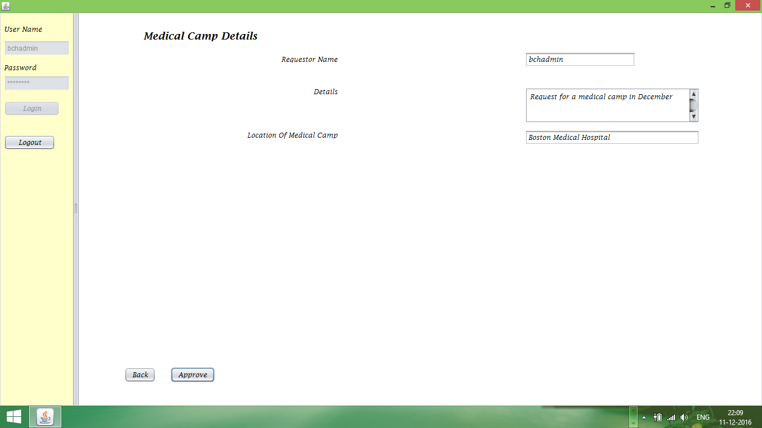
Screenshots

Slide 7
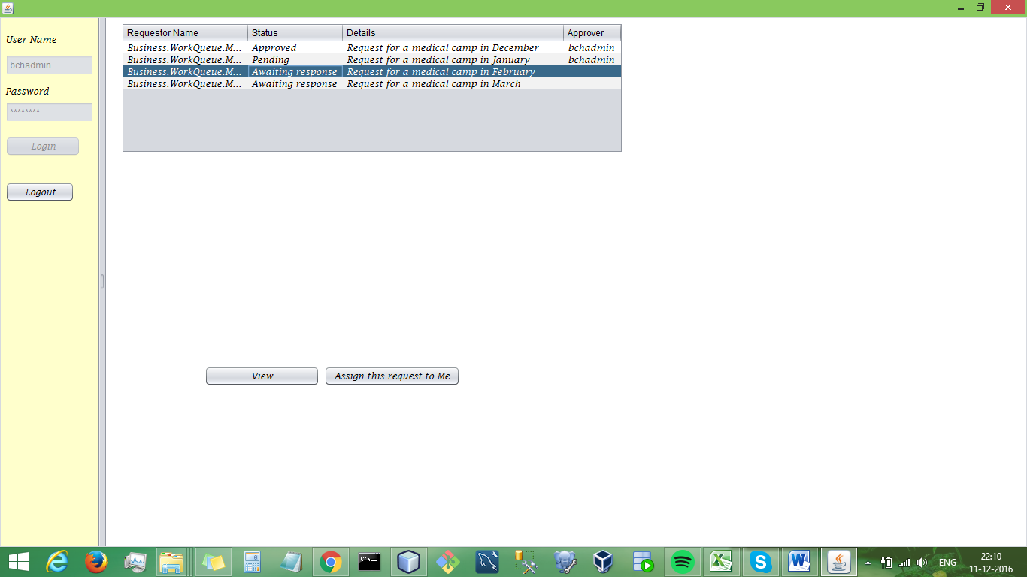

Slide 8
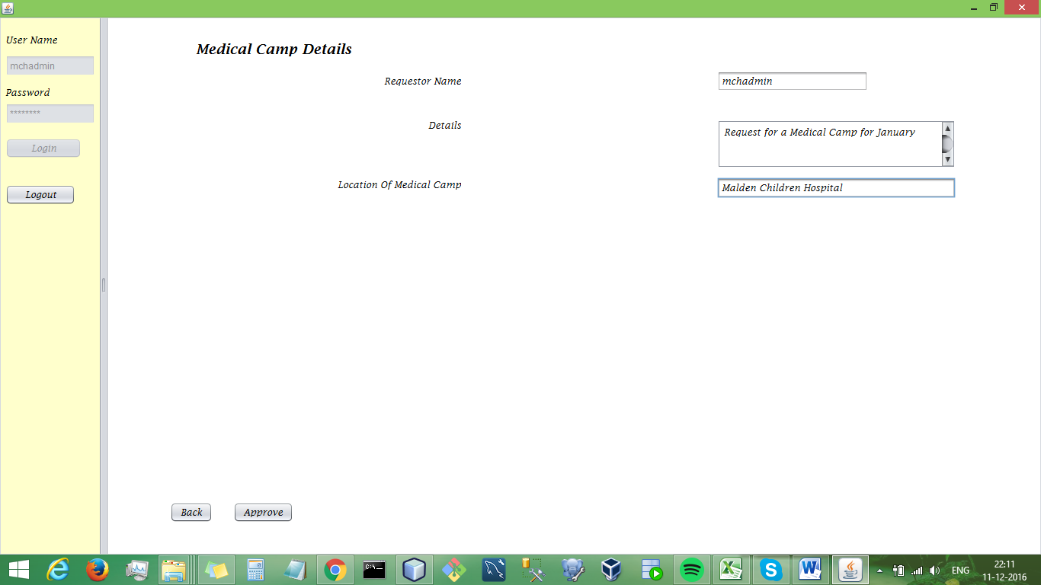

Slide 9
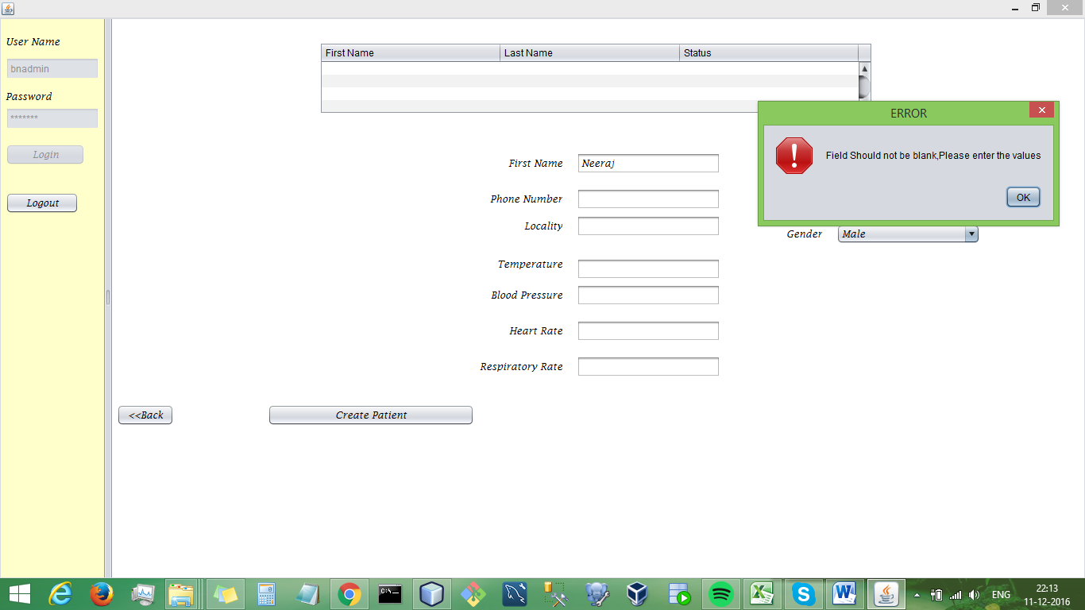

Slide 10
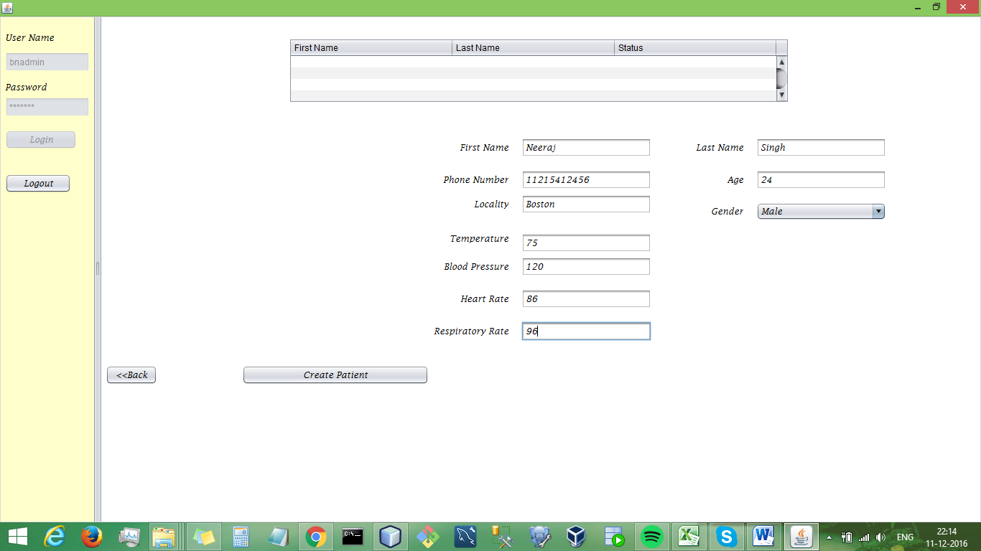

Slide 11
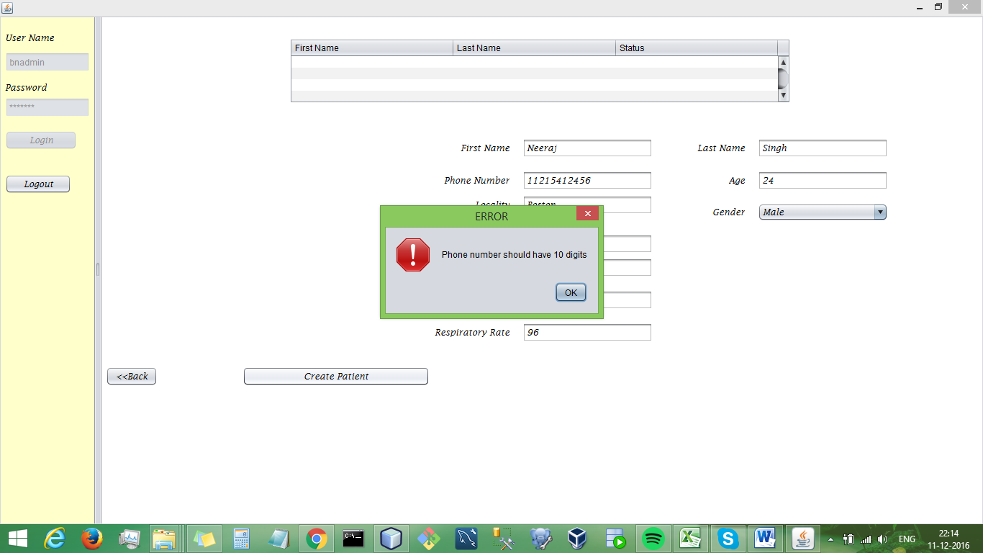

Slide 12
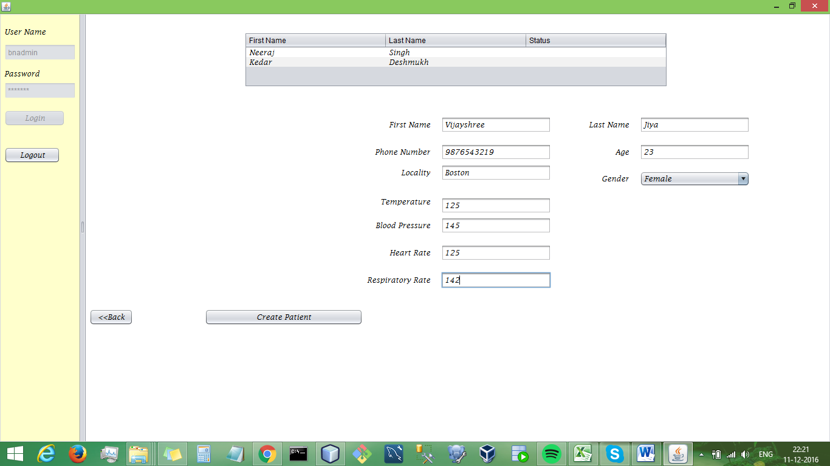

Slide 13
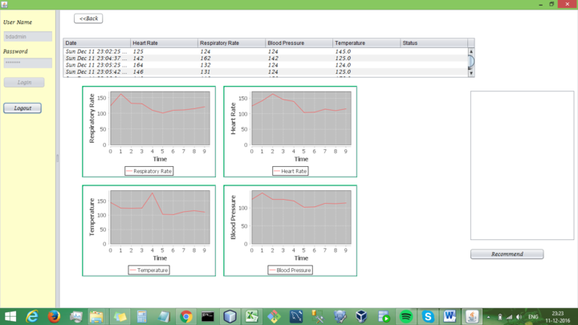

Slide 14
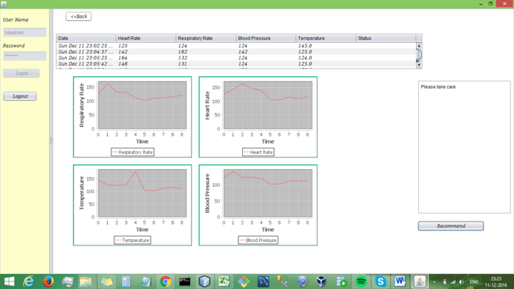

Slide 15
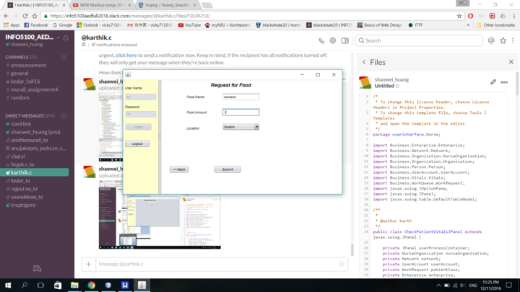

Slide 16
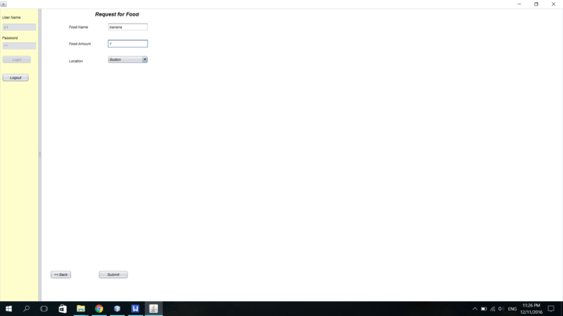

Slide 17
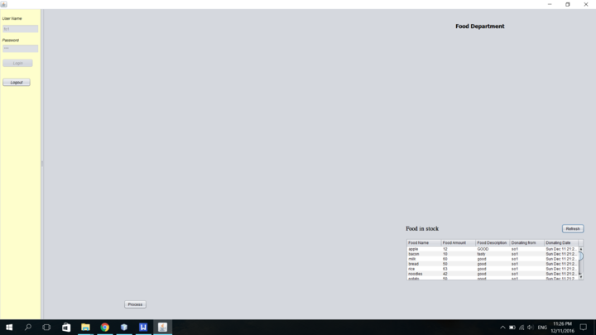

Slide 18
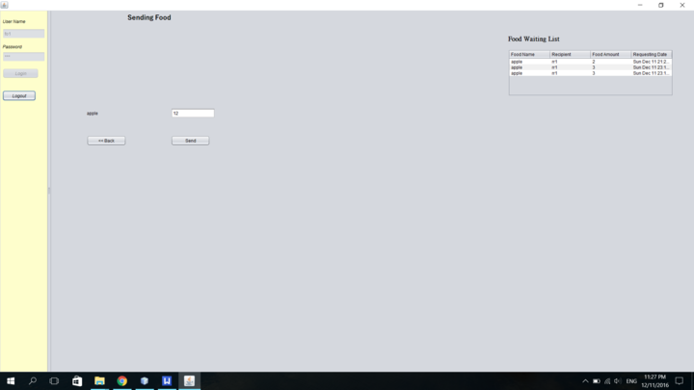

Slide 19
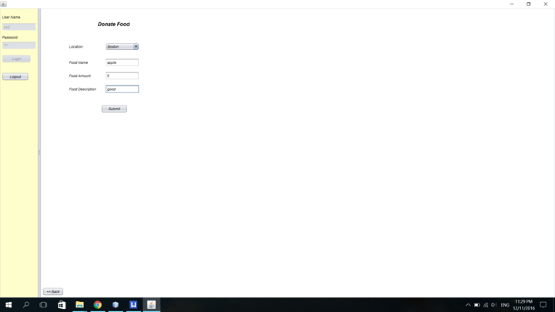

Slide 20

Let us now watch the Demo

